Slide 1
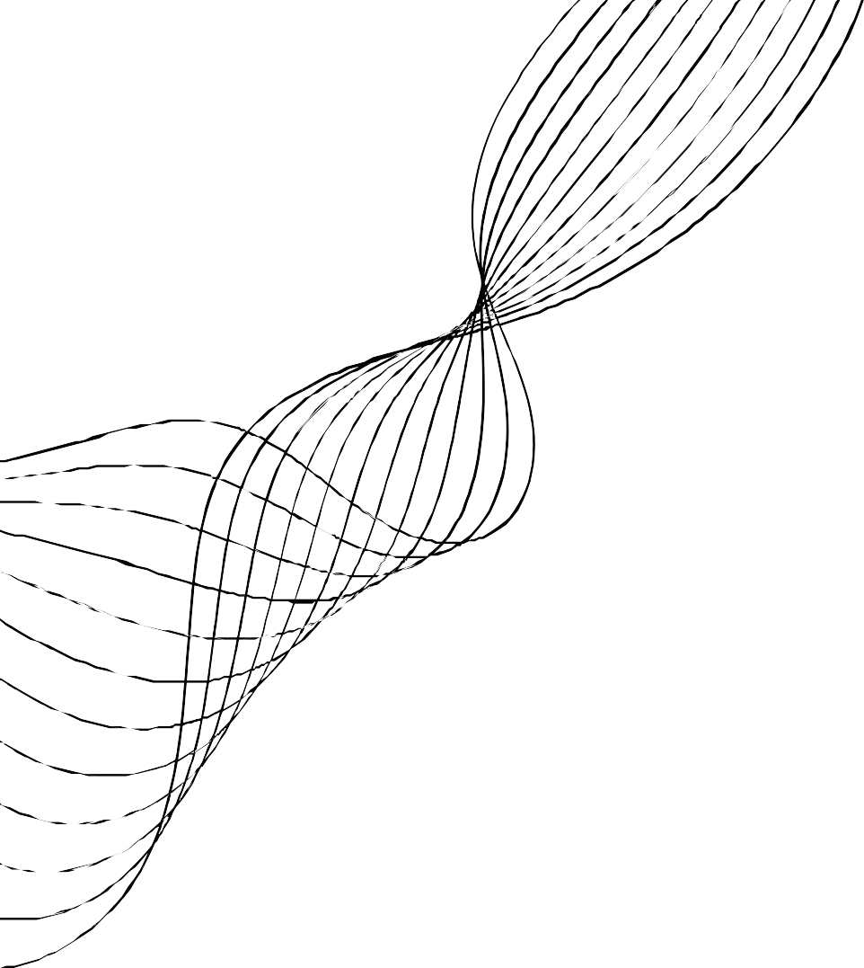

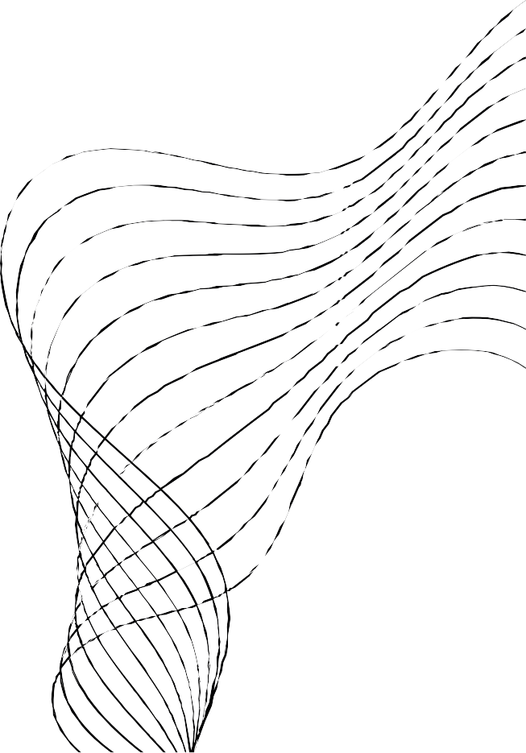
TITLE SLIDE
Team Name : Web dev intern 2
Topic of Project : About us Website
Team Members: Abhishek Goyal, Divyanshi Kulshrestha, Khushi Singh, Rishabh Dev Mishra, Sahil Wadhwa, Shiv Rai, and Umar Iqbal
Date of Internship: 11/7/24 – 30/9/24
Leader name: Shiv Rai

Slide 2


INTRODUCTION TO THE PROJECT
01
02
03
BRIEF OVERVIEW OF THE PROJECT
OBJECTIVES AND GOALS
IMPORTANCE OF THE PROJECT

Slide 3



WORK OVERVIEW
Task completed : Created About us website for Grootz
Key Milestones: Developed a fully functional website, demonstrating proficiency in modern web development tools and frameworks, including React.js, CSS, and Framer Motion. This project highlights advanced skills in creating dynamic, responsive, and visually engaging user interfaces.

Slide 4

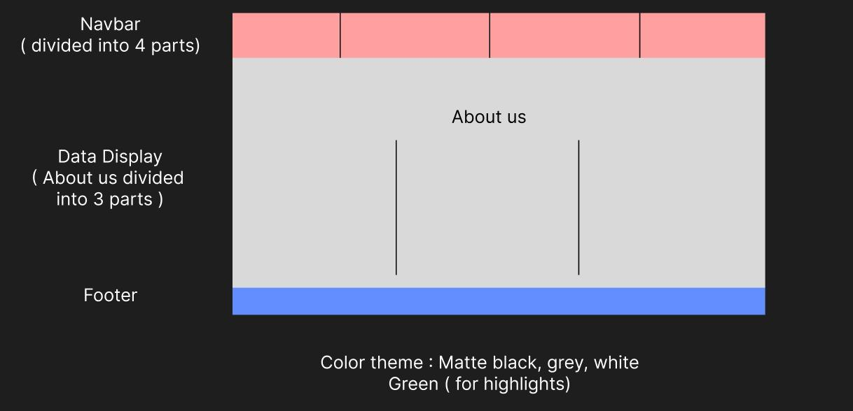
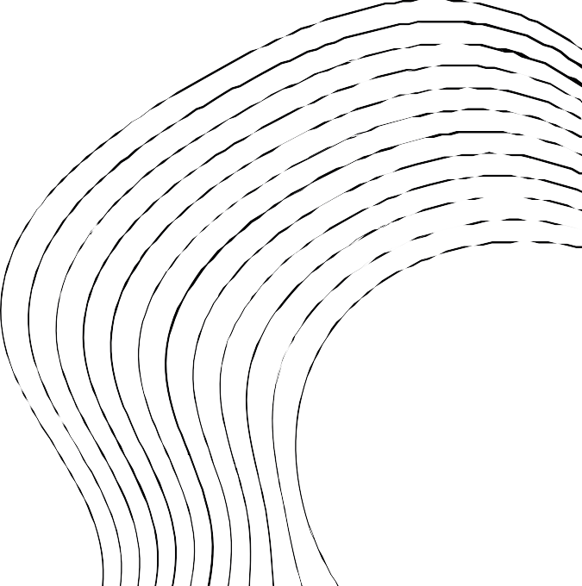
SCREENSHOTS OF WORK (1)
Representation: Delivered a comprehensive, well-structured original format to the team, serving as a blueprint to guide their workflow and ensure alignment on project objectives and deliverables.

Slide 5
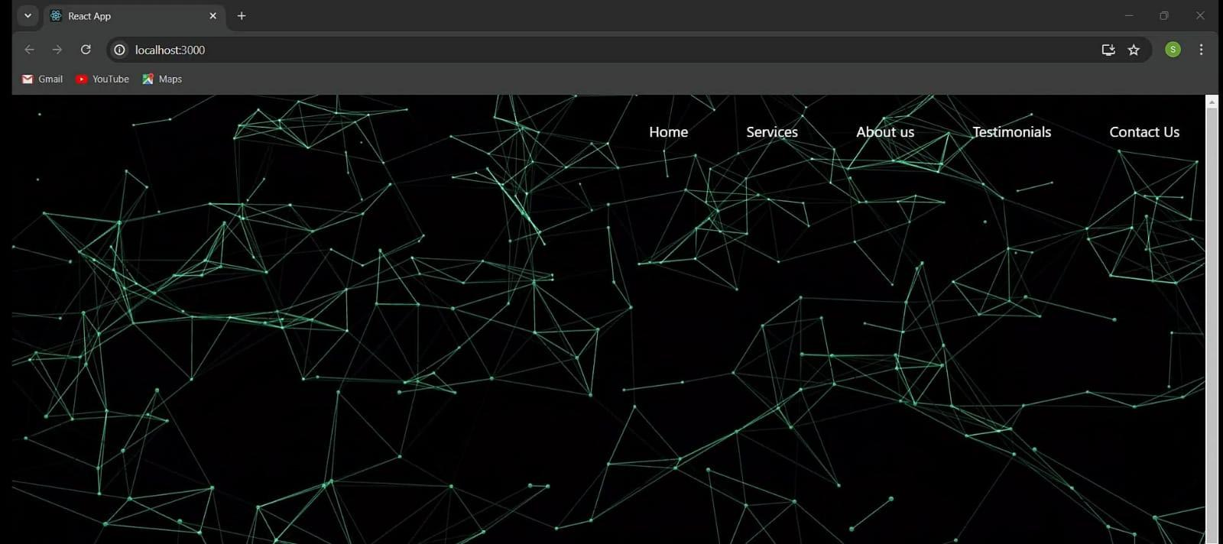
SCREENSHOTS OF WORK (2)
Current Focus: Enhancing the website to deliver a unique and immersive user experience by integrating a 3D interactive background, creating an engaging and visually distinct interface.

Slide 6
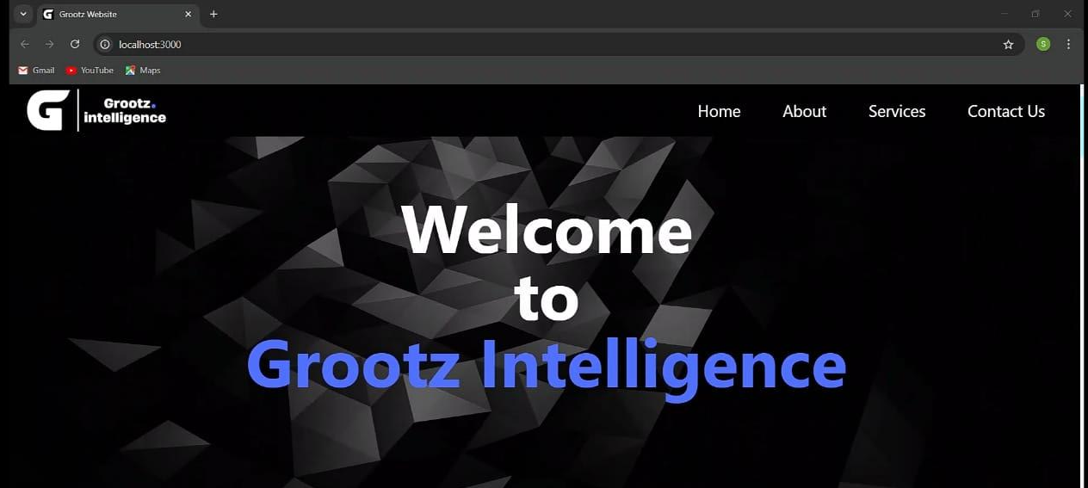
SCREENSHOTS OF WORK (3)
The final product features an updated theme, refreshed color palette, and enhanced background, giving the website a modern, vibrant, and visually appealing look.

Slide 7

TECHNICAL CHALLENGES AND SOLUTION
The challenge of :
Making the site itself
Making the site responsive
Adding animations
Solved by using :
Reactjs
CSS
Framer Motion

Slide 8

NEW SKILLS ACQUIRED
New skills acquired :
Working with Reactjs, Responsiveness using CSS, Adding Animations using Framer Motion
These skills enabled us to contribute to the full development process, from design to deployment, ensuring the site was both visually appealing and functionally strong while overcoming challenges efficiently.

Slide 9
FEEDBACK RECEIVED
Feedback Received: We received suggestions on the site's format, layout, color scheme, and overall design.
Actions Taken: We had improved the UI/UX by optimizing the layout, refining the theme, and enhancing the visual elements, which made the website more cohesive, visually attractive, and user-friendly.

Slide 10
REFLECTION AND GROWTH
This internship gave an opportunity to work on a real-world based problem as well as work in a team coordinating with each other to bring the effort of everyone to fruition.
This project can align with a web developer’s or a UI/UX designer’s goal, as they can create a similar website where they showcase and portray their skills, projects, and abilities.

Slide 11
CONCLUSION AND FUTURE STEPS
All the interns had a wonderful experience of working in a team to build something amazing together. This internship provided an excellent opportunity to grow as well as connect with some brilliant individuals.
Improve the site's smoothness and overall feel, resulting in a more seamless and enjoyable browsing experience for users.
Incorporate and optimize animations to add visual interest and improve engagement.
Refine the UI/UX design to ensure intuitive navigation and a more enjoyable user experience.

